Slide 1
Gene interactions and Epistasis

Slide 2
Dihybrid cross
Each gene locus had an independent effect on a single phenotype.
For eg. the R and r alleles affected only the shape of the seed and had no influence on seed color, while the Y and y alleles affected only seed color and had no influence on seed shape.
In this case, there were two separate genes that coded for two separate characteristics.

Slide 3
Gene interactions
A trait influenced by more than one gene is called gene interactions
Genetic interaction networks represent the functional interactions between pairs of genes in an organism and are useful for understanding the relation between genotype and phenotype
What is pleiotropy?
A single gene controls more than one character is called pleiotropy

Slide 4
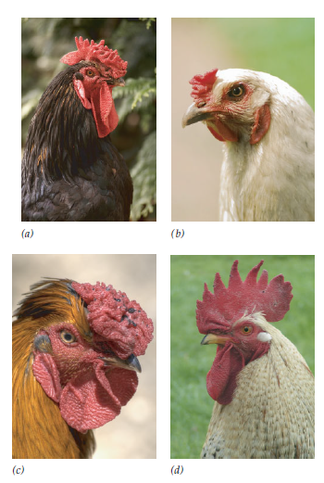
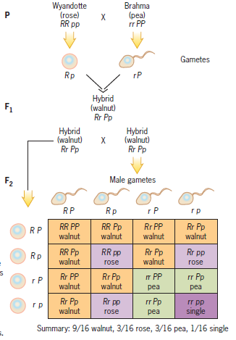
Eg: Comb shape in Chickens
R and P genes
Wyandotte/rose
Brahma/pea
Hybrid/walnut
Leghorn/single

Slide 5
Epistasis
the term epistasis comes from Greek words meaning to “stand above”.
It was first used by Bateson in 1909 to describe a masking effect
“An interaction between a pair of loci, in which the phenotypic effect of one locus depends on the genotype at the second locus”
When two or more genes influence a trait, an allele of one of them may have an overriding effect on the phenotype. When an allele has such an overriding effect, it is said to be epistatic to the other genes that are involved

Slide 6
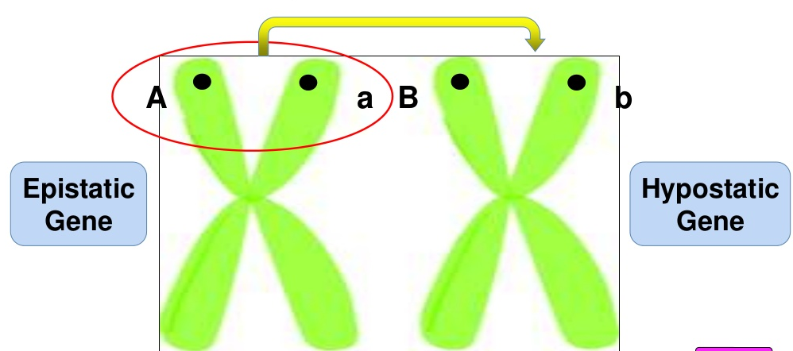

Slide 7
How can we explain the epistasis?
A gene is a chemical determiner
Gene products interact with the environment and factors such as temperature, light, hormones and enzymes, diet etc.
If there is any problem or mutation in the intermediates, it can lead to another phenotype and hence disturb the Mendelian ratios

Slide 8
Phenotype = Genotype x Environment
An organism's genotype is the set of genes that it carries
An organism's phenotype is all of its observable characteristics — which are influenced both by its genotype and by the environment
Environment plays a huge role in determining the phenotype

Slide 9
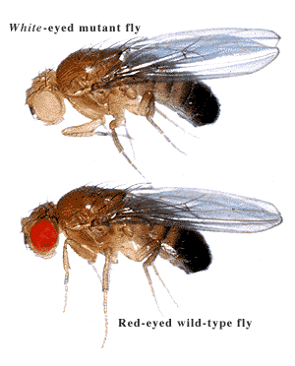
A mutant allele of one gene is epistatic to a mutant allele of another gene if it conceals the latter’s presence in the genotype.
cinnabar
cinnabar white
(double mutant)
white
What physiological mechanism makes the white mutation epistatic to the cinnabar mutation?

Slide 10
CINNABAR
WHITE
Brown
pigment
Transporter
cinnabar
white
Flies that are homozygous for the cinnabar mutation cannot synthesize brown pigment, but they can synthesize red pigment.
The polypeptide product of the wild-type allele of the white gene transports pigment into the Drosophila eye. When this gene is mutated, the transporter polypeptide is not made.

Slide 11
Dominance and Epistasis
Dominance
Involves intra gene interaction
One allele hides the effect of other allele at the same gene pair
Epistasis
Involves inter-gene interaction
One gene hides the effect of other gene at different gene loci

